Slide 1
جستجوی اطلاعات علمی

Slide 2
The scenarios
“I just join as new graduate students and I am not sure how to do a literature search”
“I have been into research for sometimes now but I spend a lot of time to get the articles I want”
“I wanted to start a new research work, how can I get the right literature in the shortest possible time?”
→ → If you experience similar concerns, this module may help you to do an effective literature search

Slide 3
Reasons for Searching the Medical Literature
To answer a specific patient case-related question (clinical practice)
To learn more about a medical topic (education)
To determine current best practice (guideline)
To give the best possible care to patients using evidence-based medicine
To do a research

Slide 4
How to start?
There are many ways to begin literature search, generally we have:
Keywords (most commonly use)
Begin from a paper given by your mentor
References from a given paper
Journals in your interest of subject areas
Authors, if you know some …
As a beginner, we will only talk about keyword search in topics or titles

Slide 5
Objectives
Formulate your question
Understand basic database structure
Use of Boolean Logic
Use Field Searching
Use of Controlled Vocabulary
Specialty techniques (truncation, etc.)
Building your search strategy

Slide 6
Simple Vs Advanced Search
Advanced search
Simple search
Very broad :retrieves thousands of irrelevant files
Narrowing the search
Boolean
Phrase searching
Field search
Truncation

Slide 7
Parsing the Question
What are the main concepts in your question?
Sample question:
Does nutrition therapy improve decubitus (pressure) ulcer healing in an elderly patient?
Concepts:
Nutrition therapy
Decubitus/pressure ulcers
Treatment efficacy
Ulcer healing
Elderly patients

Slide 8
Searching a Database
Different search interfaces do the same things in slightly different ways
Good search interfaces should provide
Ability to search for a specific item
Ability to search for related items to a known item
Ability to search in a specific field or fields
Ability to combine search terms using Boolean Logic
Ability to retrieve search results in a useful way

Slide 9
Boolean Logic
A British mathematician named George Boole (1815-1864) developed an algebraic system of logic that is now widely used in computer and electronic systems including database searching.
While Boole’s algebraic system can be complex, a very simple form of Boolean Logic is used for searching most bibliographic databases.

Slide 10
Boolean Operators
Standard Boolean Logic for database searching uses 3 relationships among search terms.
AND
OR
NOT
It is both simple and powerful.

Slide 11
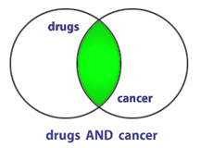
AND
BOTH terms included in any results.
If a record has only one of the two terms, it will not be retrieved.
If the record has neither term, it will not be retrieved.
What does this do to the amount of records retrieved?

Slide 12
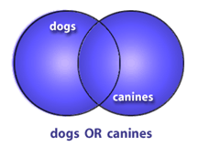
OR
Only one (NOT both) of the terms are in the results
‘OR’ will retrieve the record if both are included.
What does OR do to the amount of records retrieved?

Slide 13
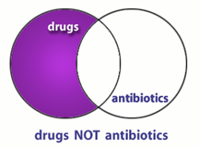
NOT
Excludes any results containing the term
Records containing both will not be retrieved.
What does NOT do to the amount of records retrieved?

Slide 14
Using OR
“OR” groupings contain terms for the same idea/concept and are usually put in parenthesis
(term OR term OR term)
where all terms are difference ways of representing the same concept
(faculty OR teachers OR professors)
(students OR learners OR pupils)

Slide 15
Using AND
“AND” groupings contain terms for different ideas/concepts and can combine OR groupings
Term AND (Term OR Term) where each represents a different concept
heart attack AND smoking
Diabetes AND exercise
Cancer AND (treatment OR therapy)

Slide 16
Using NOT
“NOT” statements are usually put last and can contain an “OR” grouping; they are often used to get rid of a common subgroup
Students NOT dental
Diabetes NOT juvenile

Slide 17
Putting Them Together
Identify the concepts (Parse the question)
List specific terms for each concept
Put the terms for each concept in an OR statements within parentheses
Combine OR statements with AND
Add any NOT statements to the end

Slide 18
Creating a Boolean Search
QUESTION: Is Vitamin C helpful in treating the flu?
Identify concepts and list terms
Concept 1 Influenza | Concept 2 Vitamin C | Concept 3 Treatment | Concept 4 helpfulness
Influenza | Vitamin C | Treatment | Outcome
Flu | Ascorbic acid | Therapy | Recovery
 | Orange Juice | Management | Success

Slide 19
Step 2
2. Make your OR statements, one per concept
(influenza OR flu OR orthomyxovirus)
(vitamin C OR ascorbic acid OR ascorbate)
(treatment OR therapy OR management)
(outcome OR recovery OR success)

Slide 20
Steps 3 and 4
3. Put “AND” between each of the OR statements
(influenza OR flu) AND (vitamin C OR ascorbic acid OR orange juice) AND (treatment OR therapy OR management) AND (outcome OR recovery OR success)
4. Consider any NOT statements you might want to add.
Note: NOT isn’t used very often

Slide 21
Parsing a Boolean Search
(emergency OR acute OR critical) AND (treatment OR therapy OR management OR care) AND (motor vehicle accident OR car crash) NOT (pedestrian OR walking)
What are the four concepts?
What terms are used for each concept?
Which three concepts must be included in all records found?
Which concept must not be included in any record found?

Slide 22
Beyond Basic Boolean
Field Searching
Controlled Vocabulary
Subject vs. Keyword Searching
Specialty Features
Truncation
Phrase searching

Slide 23
Field Searching
Almost all databases will provide you with some ability to search a specific field or fields.
Allows faster searching
Allows more accurate searching
Not all databases may make all fields searchable.
Each search system will require a specific format.

Slide 24
All Field vs. Specific Field Searches
I would like to find articles by John Smith.
Search all fields: John Smith
Search Author Field only: John Smith
I would like to find an article published in 1997.
Search all fields: 1997
Search Publication Date Field: 1997
Why waste time searching for a date in the author field or an author in the volume field?

Slide 25
Formats for Field Searching
Different databases provide different formats for specifying fields.
Most use field names or nicknames
Field ‘tags’ OR ‘labels’
which may follow a period or be placed in brackets or parentheses.
Some databases offer forms or drop-down menus.

Slide 26
PubMed Field Tags
http://www.ncbi.nlm.nih.gov/books/bv.fcgi?rid=helppubmed.section.pubmedhelp.Search_Field_Descrip
[au] = author
[ti] = title
[tw] = textword
[tiab] = title and abstract
[mh] = medical subject heading
[dp] = date of publication
[la] = language
[gr] = grant number
[ta] = journal name
[ad] = affiliation

Slide 27
Some databases, such as the Web of Science (Science Citation Index Expanded) provide forms to fill out.
Select Field from drop-down menu
Select Boolean Operator

Slide 28
Combining Field Searches
Multiple field searches can be combined using Boolean logic.
Find a 2005 article by an author named Hubble about ankle fractures.
Combine with AND:
2005 in date/year field
Hubble in author field
Ankle fractures in title field
2005[dp] AND Hubble[au] AND ankle fractures[ti]

Slide 29
Subject vs. Keyword Searching
Free-text (keyword) searching
Some concepts have many synonyms. A free-text search statement would mean "OR"ing all those terms together
Controlled vocabulary searching
You need to consult a thesaurus (paper or online) to find out what the controlled vocabulary term is for each concept.

Slide 30
Controlled Vocabulary
A controlled vocabulary is a set of established terms where
every term represents a single concept
only one term is used for that concept

Slide 31
Another example
How many words could you think of for the idea of “cancer”?
Cancer, tumor, malignancy, neoplasm, sarcoma…
Articles in a database
Article one: “Breast tumors in young women”
Article two: “Surgery for prostrate cancer.”
Article three: “Diagnosing Melanoma.”
All three articles are about types of cancer but different terms are used in titles.

Slide 32
In a controlled vocabulary ONE word (i.e., cancer) is chosen and placed in a special field, usually called a subject field.
For all three articles
Article one: “Breast tumors in young women”
Article two: “Surgery for prostrate cancer.”
Article three: “Diagnosing Melanoma.”
The subject term (concept term) “cancer” is placed in the subject field by database indexers.
’ find?

Slide 33
Advantages to Controlled Vocabularies
Using the controlled vocabulary can make your search more precise and easier.
Increases the relevancy of results (fewer false drops)
The indexers have already done much of the work for you.
Searchable tree structures of terms can help you find new terms to use.

Slide 34
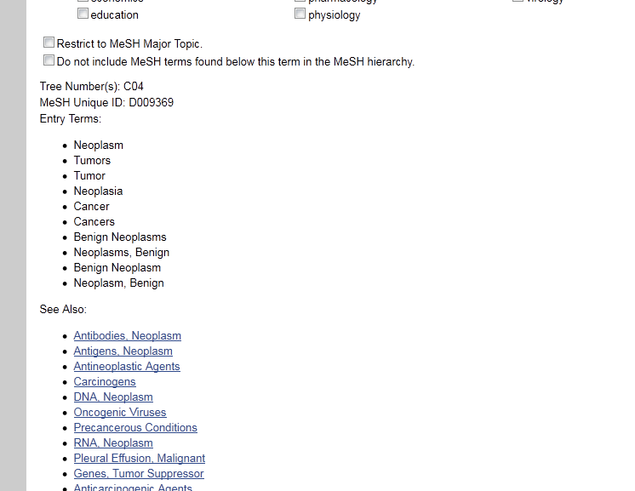

Slide 35
Structure of Controlled Vocabulary
Broader Concepts
Narrower Concepts

Slide 36
Problems with Controlled Vocabularies
NOT all databases use a controlled vocabulary
New concepts take time to be added
There is often a lag phase during which the newest articles aren’t indexed
Controlled vocabularies can contain some very strange things and some concepts may not be handled well
The controlled vocabulary must be easily searchable

Slide 37
Some Specialty Features
Truncation
Phrase searching
Neighboring and other rarer Boolean operators

Slide 38
Truncation
What about including the singular and plural versions of words as well as other word variations?
For example: therapy, therapies, therapeutics,
You could combine them all in an OR relationship:
(therapy OR therapies OR therapeutics OR therapeutic)

Slide 39
But an easier way is by the use of truncation.
therap*
Each database handles truncation in a unique way.
The ‘*’ and ‘$’ are the most common wildcard symbols.

Slide 40
More on Truncation
Some examples:
Bacter$
Proc* Vir? Staph?

Slide 41
Be cautious when truncating!
If the word stem is too short, there may be too many possible variations and you might pick up unrelated terms.
For example, using proc* for finding procaine-like drugs will also include words like proceedings and process.

Slide 42
Phrase Searching
Sometimes you want to force the database to search for a set of words in exact order
“fever of unknown origin”
Most databases will accept a phrase in quotes.
BUT…some do not handle phrases well and will automatically break them up – usually ‘AND’-ing the terms
Check how the database handles phrase searching before doing it!

Slide 43
Limits Options
Many databases provide “limits” pages that make it easier for you to select common options such as language, article type, publication dates, human or animal, gender, age groups, etc.
Each database’s limits options are unique
Most limits can be done ‘by hand’ using field tags, but sometimes limit pages save time

Slide 44
PubMed Limits Page

Slide 45
Step-By-Step Search Construction
State the question
Identify the concepts in the question
For each concept, determine keywords and subject terms
Specify field tags after terms if needed
Combine terms for the same concept with “OR” in parenthesis
Combine “OR” statements with AND
Put any NOT terms at the end
Keep track of your searches, how many articles were found total, and how many you selected as relevant

Slide 46
Final Notes on Fields
Each database provides its own specific fields
Each database requires a specific format to designate field searching
When searching a new database, take a moment to read the help documentation; most will provide a list of fields and how to search them.

Slide 47
Don’t forget…
Boolean logic to combine terms
Use of other search fields in combination with subject terms
A Complex Search:
(head[mh] OR head[tw]) AND (wound and injuries[mh] OR trauma[ti] OR injury[ti]) AND 2005[dp] AND English[la]

Slide 48
Example
Question: What is the appropriate ED medical management of adult patients with intracranial hemorrhage (either trauma or spontaneous)?
Notes:
(Emergency medical services[mh] OR "emergency room"[tw] OR "emergency department"[tw])
Intracranial Hemorrhages[mh]
Intracerebral hemorrhage[tw]
Intracranial hemorrhage[tw]
Anticoagulants[mh]
Anticoagulants [Pharmacological Action]
Anticoagul*[tw]
(Emergency medical services[mh] OR "emergency room"[tw] OR "emergency department"[tw]) AND (Intracranial Hemorrhages[mh] OR Intracerebral hemorrhage[tw] OR Intracranial hemorrhage[tw]) AND (Anticoagulants[mh] Anticoagulants [Pharmacological Action] OR Anticoagul*[tw]) AND 2000:2008[dp]
YIELD: 20
(Emergency medical services[mh] OR "emergency room"[tw] OR "emergency department"[tw]) AND (Intracranial Hemorrhages[mh] OR Intracerebral hemorrhage[tw] OR Intracranial hemorrhage[tw]) AND 2000:2008[dp] AND review[pt]
(Intracranial Hemorrhages[mh] OR Intracerebral hemorrhage[tw] OR Intracranial hemorrhage[tw]) AND (Anticoagulants[mh] Anticoagulants [Pharmacological Action] OR Anticoagul*[tw]) AND 2000:2008[dp] AND review[pt]

